Slide 1
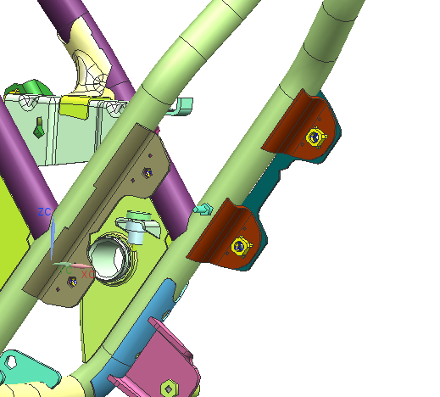
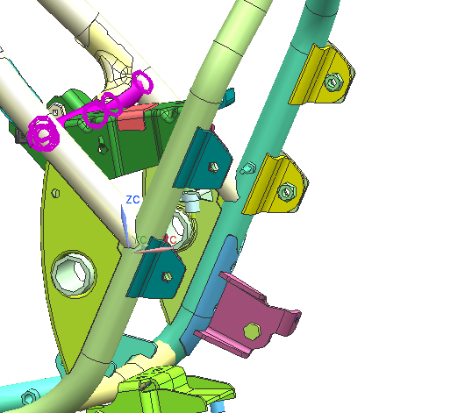
Kaizen (FA_01 I 03.2) : No of parts Reduction.
Theme |  | No of parts Reduction by Design Change. | Action | Bracket Design Change.
Part |  | Pillion stay Bracket LH RH (DS161050/DX161061) | After
Before
Result | P- Part count reduced from 4 to 2 No's |  | Benefits- | 1. - Quality of component improved – Part concentricity achieved at frame level.
4
1
2
3
2
1
Total Parts-4 nos.
Total Parts-2 nos.
1

