Slide 1
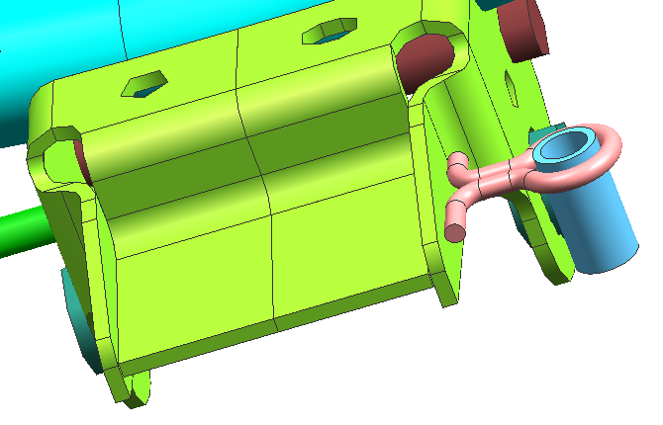
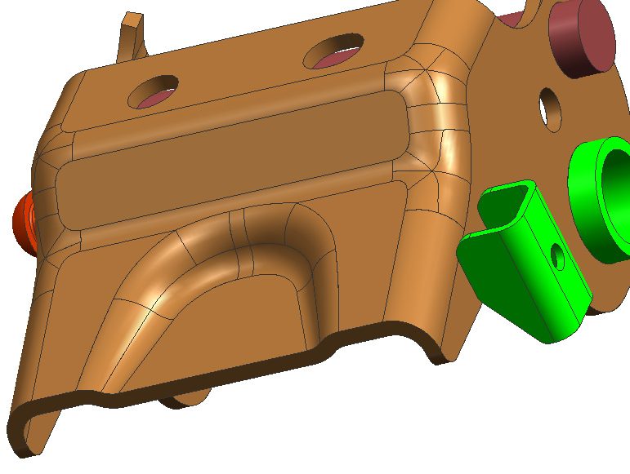
Kaizen (FA_01 I 03.3) : No of parts Reduction.
Theme |  | No of parts Reduction by Design Change. | Action | Part design change.
Part |  | Hook for vent tube(JZ113803) | After
Before
Result | P- Part count reduced from 2 to 1 No's |  | Benefits- | Hook deleted. Ease for Subassly of parts.
Total Parts-2 nos.
Total Parts-1 nos.
1

