Slide 1
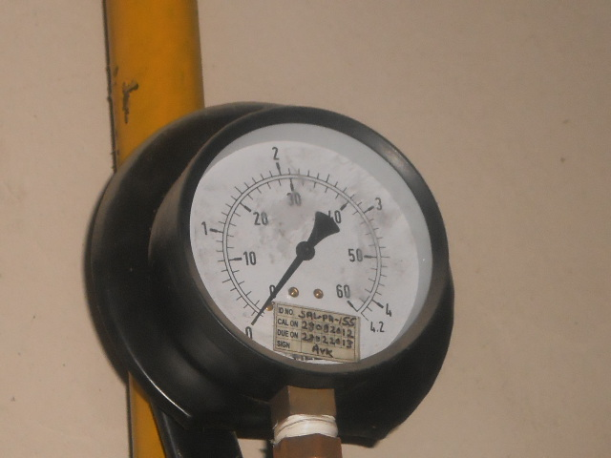
IMPROVEMENT PHOTOGRAPH
BEFORE
AFTER
Befor there was no arrangements to detect LPG pressure
If the LPG pressure goes below 0.5 kg/cm² bulb will glow & buzzer will ring

Slide 2
KAIZEN STORY
Solution Implemented: Buzzer & bulb installed for LPG pressure detection .If LPG pressure goes below 0.5 kg/cm² bulb will glow and buzzer will play.
Lesson learnt and Benefits : We can able to detect LPG pressure it is in under specification .Bad effects of low LPG pressure on brazed parts will not occur.

