Slide 1
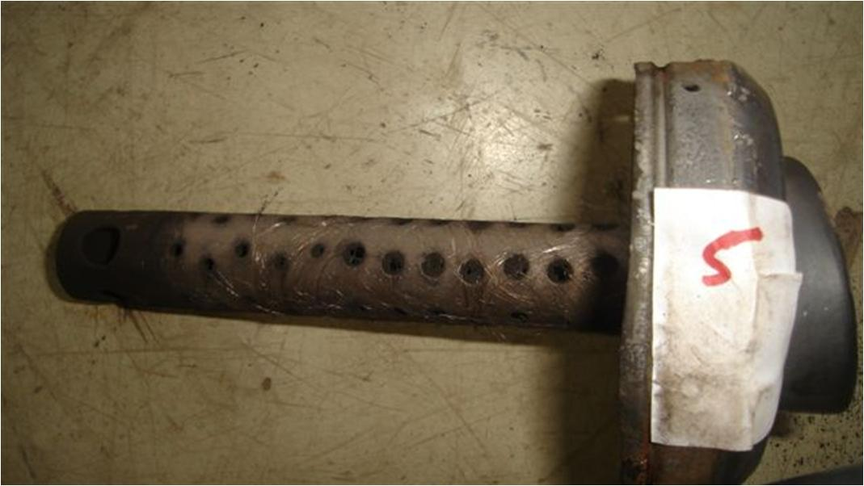
Tail Pipe Hole chock up by carbon after use

