Slide 1
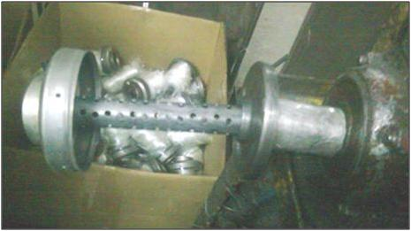
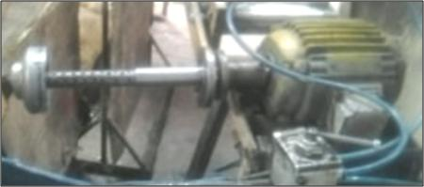
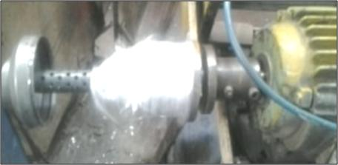
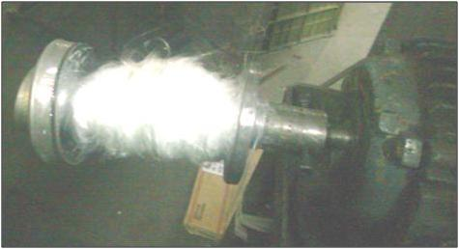
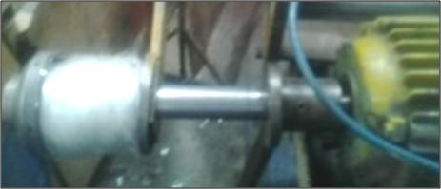
BEFORE
AFTER
1 Body C load in template
2 Glass wool wrap on shaft OD 30 mm
3 Transfer glass wool on tail pipe
Glass wool wrapping
on tail pipe

