Slide 1
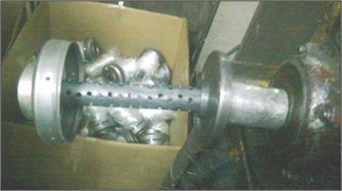
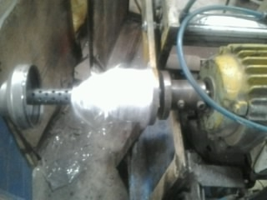
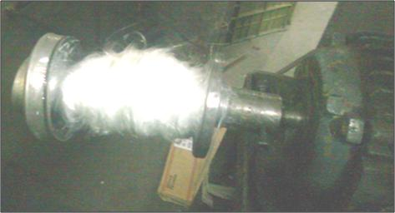
Loose glass wool wrapping on tail pipe – K1/K2 Silencer
TPM
A Journey towards excellence
Before
After
1 Body C load in template
2 Glass wool wrap on shaft OD 30 mm
3 Transfer glass wool on tail pipe
Glass wool wrapping on tail pipe
Root cause: Glass wool wrapping on Body C tail pipe itself leads to tightly fit on pipe (tail pipe OD 25mm)
Glass wool wrapping on template pipe OD is 30 mm and transfer on tail pipe to avoid tight fit on pipe.

