Slide 1
Action Implemented
THEME : Detection of Specified Torque Eagle Liquid Pressure Switch Assembly.
QUALITY
PRODUCTIVITY
COST
SAFETY

Slide 2
“HUMAN ERROR PREVENTION SUMMARY “
Team Member: Mr.Hardesh, Mr.Salman, Mr.Jitendra, MrV.Thete. Mr.Dharamraj.
Start Date:10/01/2013,
End Date:18/02/2013.
Part No:V4514002
Part Name: Eagle Liquid
Model: M & M Scorpio
Poka-yoke Details: Sensor cylinder &PLC provided. Sensor will sense tube after that cylinder will lock the tube . Pressure switch tighten by torque wrench with specified torque cylinder will de-clamp the tube . Buzzer will ring.
Problem: Pressure Switch not tighten with specified torque.
Problem Reported at : M&M Nasik.
Analysis Details : 1.) Pressure switch loose.
2.)Pressure switch not tighten with specified torque.
3.)No automation to identify specified torque.
4.) Pokayoke required to identify specified torque.
Results : Pressure switch tighten with specified torque.
Type of POKAYOKE :
Proactive : Reactive :
Detection : Prevention :

Slide 3
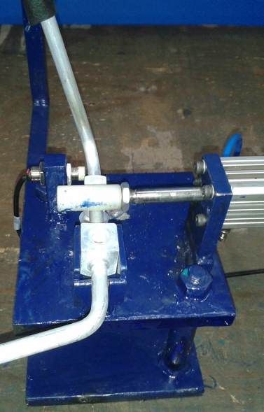
IMPROVEMENT PHOTOGRAPH
BEFORE
AFTER
Before there was no arrangements to detect specified torque.
Insert the part into the fixture sensor will sense & cylinder will lock the part.

Slide 4
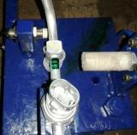
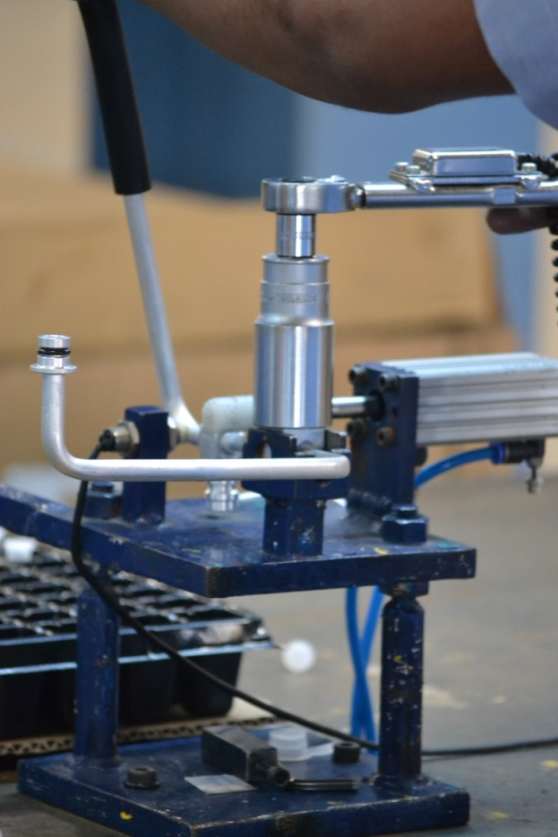
IMPROVEMENT PHOTOGRAPH
AFTER
Tight the pressure switch with torque wrench with specified torque
After tighten the pressure switch cylinder will unlock the part
When part get unlock buzzer will ring

Slide 5
Thank You…

